Slide 1

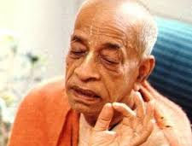
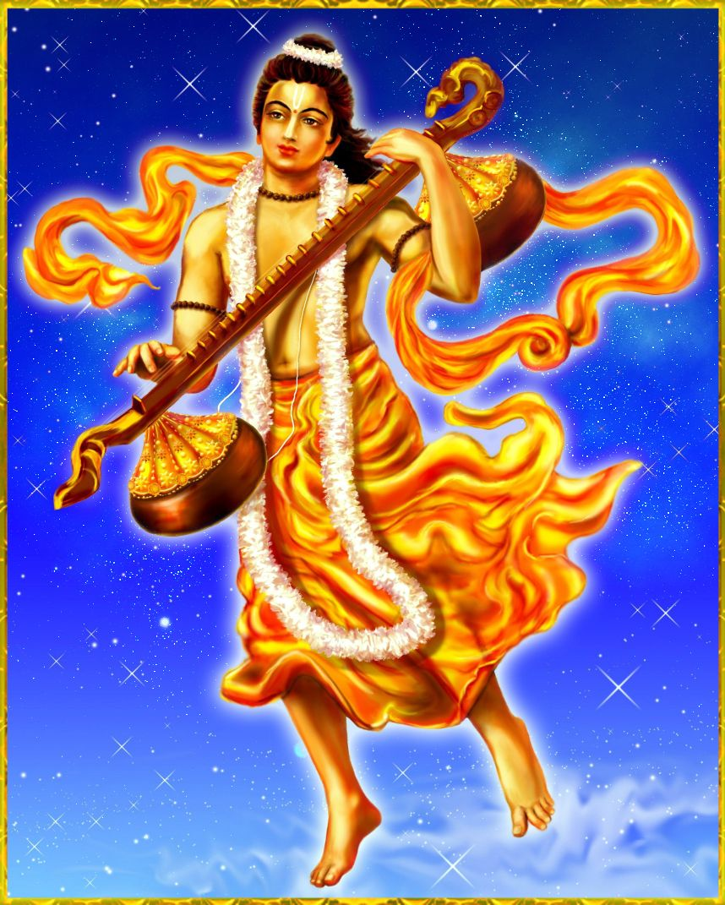
Transcendental Life of Narada Muni SB 1.6
How Narada Muni as a son of a humble maid servant gained real freedom and association of Krishna

Slide 2
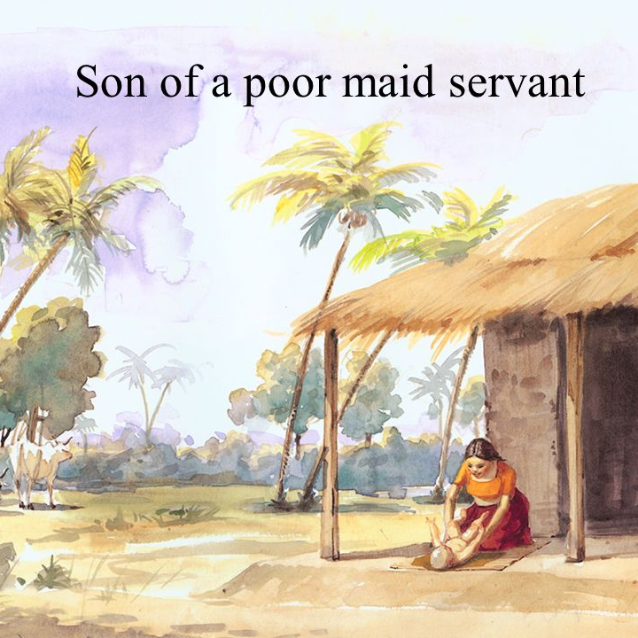
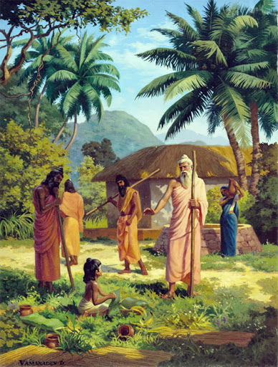

Slide 3
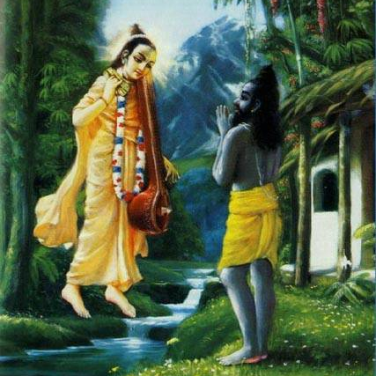
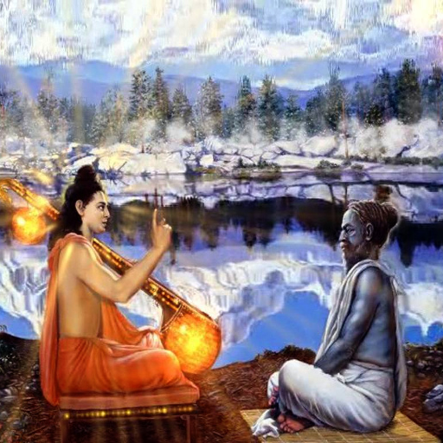
Question by Vyasadeva[1-4]
Sūta said: O brāhmaṇas, thus hearing all about Śrī Nārada’s birth and activities, Vyāsadeva, the incarnation of God and son of Satyavatī, inquired as follows.
Śrī Vyāsadeva said: What did you [Nārada] do after the departure of the great sages who had instructed you in scientific transcendental knowledge before the beginning of your present birth?
O son of Brahmā, how did you pass your life after initiation, and how did you attain this body, having quit your old one in due course?
O great sage, time annihilates everything in due course, so how is it that this subject matter, which happened prior to this day of Brahmā, is still fresh in your memory, undisturbed by time?

Slide 4
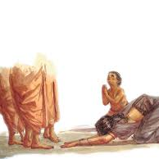
Loving Mother dies and Narada takes that special mercy sets to travel alone to unknown lands[5-10]
Śrī Nārada said: The great sages, who had imparted scientific knowledge of transcendence to me, departed for other places, and I had to pass my life in this way.
I was the only son of my mother, who was not only a simple woman but a maidservant as well. Since I was her only offspring, she had no other alternative for protection: she bound me with the tie of affection.
She wanted to look after my maintenance properly, but because she was not independent, she was not able to do anything for me. The world is under the full control of the Supreme Lord; therefore everyone is like a wooden doll in the hands of a puppet master.
When I was a mere child of five years, I lived in a brāhmaṇa school. I was dependent on my mother’s affection and had no experience of different lands.
Once upon a time, my poor mother, when going out one night to milk a cow, was bitten on the leg by a serpent, influenced by supreme time.
I took this as the special mercy of the Lord, who always desires benediction for His devotees, and so thinking, I started for the north.

Slide 5
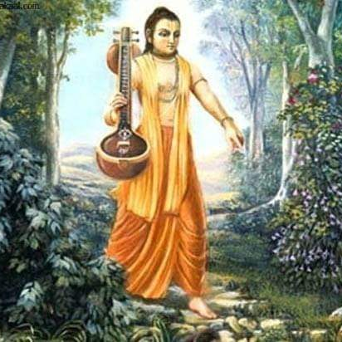
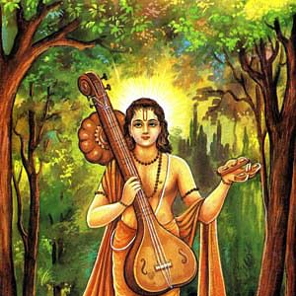
Travel Description[11-14]
After my departure, I passed through many flourishing metropolises, towns, villages, animal farms, mines, agricultural lands, valleys, flower gardens, nursery gardens and natural forests.
I passed through hills and mountains full of reservoirs of various minerals like gold, silver and copper, and through tracts of land with reservoirs of water filled with beautiful lotus flowers, fit for the denizens of heaven, decorated with bewildered bees and singing birds.
I then passed alone through many forests of rushes, bamboo, reeds, sharp grass, weeds and caves, which were very difficult to go through alone. I visited deep, dark and dangerously fearful forests, which were the play yards of snakes, owls and jackals.
Thus traveling, I felt tired, both bodily and mentally, and I was both thirsty and hungry. So I took a bath in a river lake and also drank water. By contacting water, I got relief from my exhaustion.

Slide 6
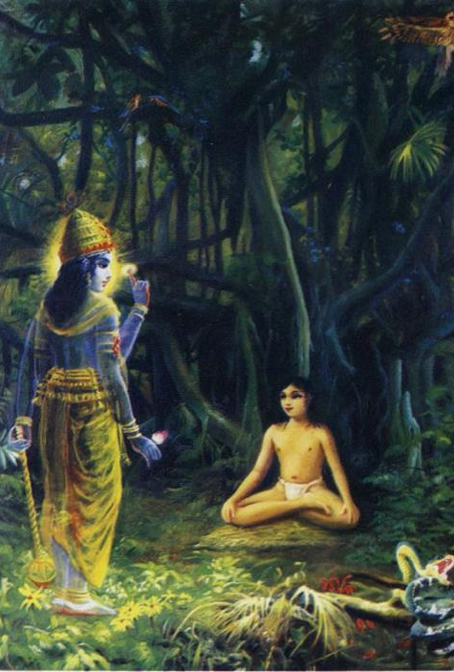
Meditation on Lord [15-19]
After that, under the shadow of a banyan tree in an uninhabited forest I began to meditate upon the Supersoul situated within, using my intelligence, as I had learned from liberated souls.
As soon as I began to meditate upon the lotus feet of the Personality of Godhead with my mind transformed in transcendental love, tears rolled down my eyes, and without delay the Personality of Godhead, Śrī Kṛṣṇa, appeared on the lotus of my heart.
O Vyāsadeva, at that time, being exceedingly overpowered by feelings of happiness, every part of my body became separately enlivened. Being absorbed in an ocean of ecstasy, I could not see both myself and the Lord.
The transcendental form of the Lord, as it is, satisfies the mind’s desire and at once erases all mental incongruities. Upon losing that form, I suddenly got up, being perturbed, as is usual when one loses that which is desirable.
I desired to see again that transcendental form of the Lord, but despite my attempts to concentrate upon the heart with eagerness to view the form again, I could not see Him any more, and thus dissatisfied, I was very much aggrieved.

Slide 7
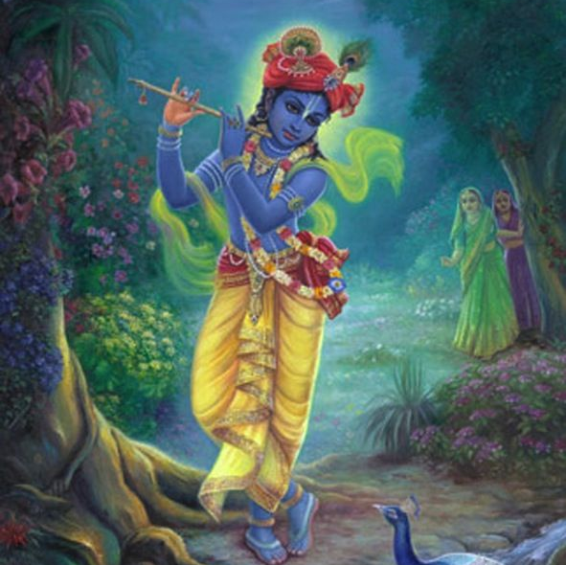
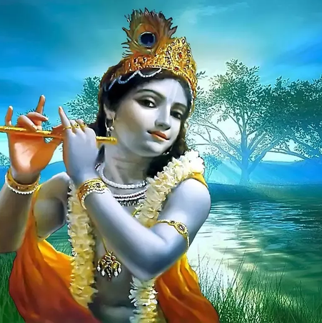
Lord Spoke [20-24]
Seeing my attempts in that lonely place, the Personality of Godhead, who is transcendental to all mundane description, spoke to me with gravity and pleasing words, just to mitigate my grief.
O Nārada [the Lord spoke], I regret that during this lifetime you will not be able to see Me anymore. Those who are incomplete in service and who are not completely free from all material taints can hardly see Me.
O virtuous one, you have only once seen My person, and this is just to increase your desire for Me, because the more you hanker for Me, the more you will be freed from all material desires.
By service of the Absolute Truth, even for a few days, a devotee attains firm and fixed intelligence in Me. Consequently he goes on to become My associate in the transcendental world after giving up the present deplorable material worlds.
Intelligence engaged in My devotion cannot be thwarted at any time. Even at the time of creation, as well as at the time of annihilation, your remembrance will continue by My mercy.

Slide 8
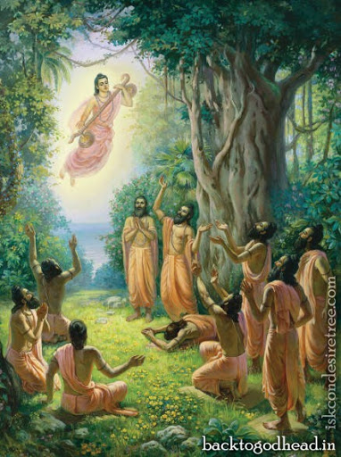
Transcendental Journey [25-29]
Then that supreme authority, personified by sound and unseen by eyes, but most wonderful, stopped speaking. Feeling a sense of gratitude, I offered my obeisances unto Him, bowing my head.
Thus I began chanting the holy name and fame of the Lord by repeated recitation, ignoring all the formalities of the material world. Such chanting and remembering of the transcendental pastimes of the Lord are benedictory. So doing, I traveled all over the earth, fully satisfied, humble and unenvious.
And so, O Brāhmaṇa Vyāsadeva, in due course of time I, who was fully absorbed in thinking of Kṛṣṇa and who therefore had no attachments, being completely freed from all material taints, met with death, as lightning and illumination occur simultaneously.
Having been awarded a transcendental body befitting an associate of the Personality of Godhead, I quit the body made of five material elements, and thus all acquired fruitive results of work [karma] stopped.
At the end of the millennium, when the Personality of Godhead, Lord Nārāyaṇa, lay down within the water of devastation, Brahmā began to enter into Him along with all creative elements, and I also entered through His breathing.

Slide 9
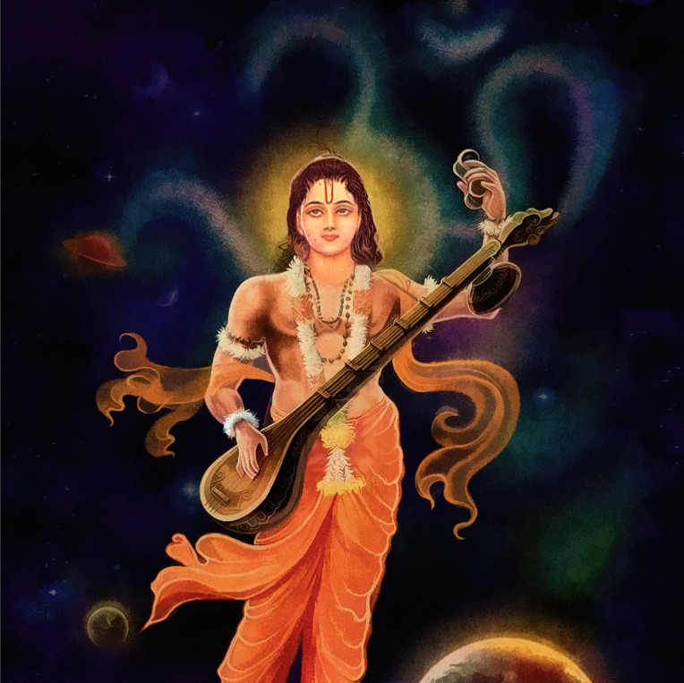
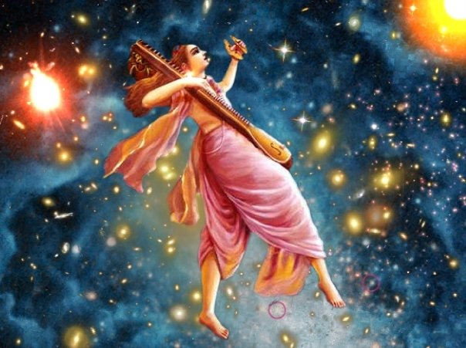
Narada Advice
After 4,300,000,000 solar years, when Brahmā awoke to create again by the will of the Lord, all the ṛṣis like Marīci, Aṅgirā, Atri and so on were created from the transcendental body of the Lord, and I also appeared along with them.
Since then, by the grace of the almighty Viṣṇu, I travel everywhere without restriction both in the transcendental world and in the three divisions of the material world. This is because I am fixed in unbroken devotional service of the Lord.
And thus I travel, constantly singing the transcendental message of the glories of the Lord, vibrating this instrument called a vīṇā, which is charged with transcendental sound and which was given to me by Lord Kṛṣṇa.
The Supreme Lord Śrī Kṛṣṇa, whose glories and activities are pleasing to hear, at once appears on the seat of my heart, as if called for, as soon as I begin to chant His holy activities.
It is personally experienced by me that those who are always full of cares and anxieties due to desiring contact of the senses with their objects can cross the ocean of nescience on a most suitable boat — the constant chanting of the transcendental activities of the Personality of Godhead.

Slide 11
SB 1.6.35
यमादिभिर्योगपथै: कामलोभहतो मुहु: । मुकुन्दसेवया यद्वत्तथात्माद्धा न शाम्यति ॥ ३५ ॥
yamādibhir yoga-pathaiḥ kāma-lobha-hato muhuḥ mukunda-sevayā yadvat tathātmāddhā na śāmyati
yama-ādibhiḥ — by the process of practicing self-restraint; yoga-pathaiḥ — by the system of yoga (mystic bodily power to attain the godly stage); kāma — desires for sense satisfaction; lobha — lust for satisfaction of the senses; hataḥ — curbed; muhuḥ — always; mukunda — the Personality of Godhead; sevayā — by the service of; yadvat — as it is; tathā — like that; ātmā — the soul; addhā — for all practical purposes; na — does not; śāmyati — be satisfied.
It is true that by practicing restraint of the senses by the yoga system one can get relief from the disturbances of desire and lust, but this is not sufficient to give satisfaction to the soul, for this [satisfaction] is derived from devotional service to the Personality of Godhead.

Slide 12
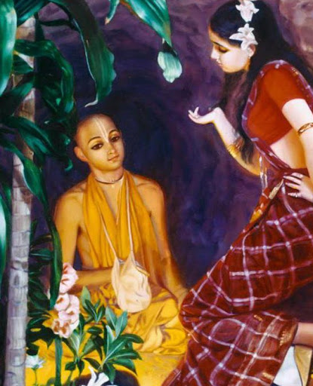
Yoga vs Bhakti :: Visvamitra vs ?? SB 1.6.35 - T2+P4
Translation
Practicing restraint of the senses by the yoga system one can get relief from the disturbances of desire and lust is not sufficient
Satisfaction is derived from devotional service to the SPG.
Purport
Yoga aims at controlling the senses which are considered as poisonous snakes or forest fire of material existence
Bhakti = extinguishes this forest fire of material life + develops the beautiful flower garden of bhakti that gives us real satisfaction
Bhakti is more effective and practical for senses are transcendentally engaged
Visvamitra vs Haridas thakur
Pure devotional service is transcendental in nature, and the systems of yoga and jñāna are subordinate to such a process.

Slide 13
SB 1.6.36
सर्वं तदिदमाख्यातं यत्पृष्टोऽहं त्वयानघ । जन्मकर्मरहस्यं मे भवतश्चात्मतोषणम् ॥ ३६ ॥
sarvaṁ tad idam ākhyātaṁ yat pṛṣṭo ’haṁ tvayānagha janma-karma-rahasyaṁ me bhavataś cātma-toṣaṇam
sarvam — all; tat — that; idam — this; ākhyātam — described; yat — whatever; pṛṣṭaḥ — asked by; aham — me; tvayā — by you; anagha — without any sins; janma — birth; karma — activities; rahasyam — mysteries; me — mine; bhavataḥ — your; ca — and; ātma — self; toṣaṇam — satisfaction.
O Vyāsadeva, you are freed from all sins. Thus I have explained my birth and activities for self-realization, as you asked. All this will be conducive for your personal satisfaction also.

Slide 14
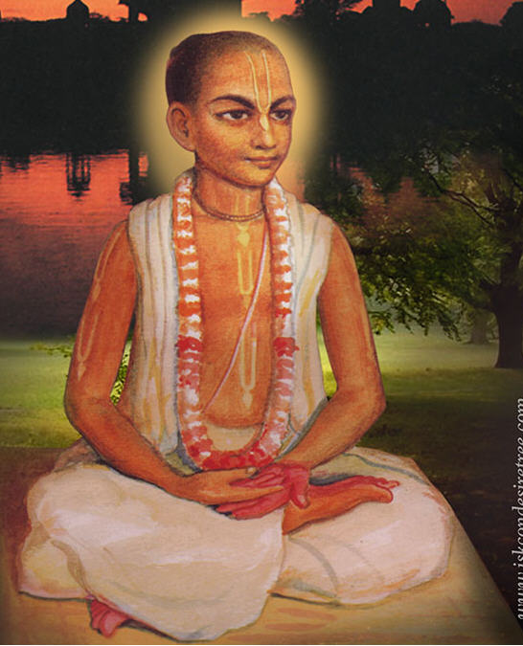
Pure Devotee pastimes gives soul satisfaction SB 1.6.36 - T2+P4
Translation
Questions and answers related to pure devotees gives us real benefit
Satisfaction is derived from listening to the pastimes of pure devotees.
Purport
Seed of devotion = transcendental association + Hearing + Service
Devotion brings detachment from worldliness → ability to handle distress
Sincere urge to meet the Lord CAN be realized by His mercy
Pure devotional service transforms of material body to spiritual one.
Hearing about pure devotees give us great confidence
Example: Seeing a product running in production
Pure devotion gives us real freedom
Like a faithful son has access to fathers whole house

Slide 15
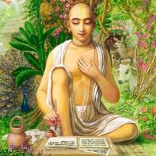
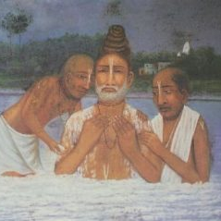
Narottam Das Thakur Ocean of compassion
From the kayastha community, very wealthy landowner but considered to be of the sudra cast.
Went to Vrindavana - Jiva Gosvami personally told him to take initiation from Lokanatha dasa Gosvami
Incredible disappearance pastime
He asked his disciples to bring him to the Ganges and pour the water on his body with their bare hands. While bathing they saw his skin turn white and it started to melt. Touched by the water of the Ganges, his body was turning into milk and was just merging into the Ganges. They saw their Gurudev was getting smaller slowly melting away.
Wrote Prarthana and Prema-bhakti-Chandrika
He wrote many devotional songs
Sri Krsna Caitanya Prabhu doya koro more
Guru Vandana
Je anilo prema dhana
gauranga' bolite ha'be pulaka-sarira

Slide 16
SB 1.6.37
सूत उवाच एवं सम्भाष्य भगवान्नारदो वासवीसुतम् । आमन्‍त्र्य वीणां रणयन् ययौ याद‍ृच्छिको मुनि: ॥ ३७ ॥
sūta uvāca evaṁ sambhāṣya bhagavān nārado vāsavī-sutam āmantrya vīṇāṁ raṇayan yayau yādṛcchiko muniḥ
sūtaḥ — Sūta Gosvāmī; uvāca — said; evam — thus; sambhāṣya — addressing; bhagavān — transcendentally powerful; nāradaḥ — Nārada Muni; vāsavī — named Vāsavī (Satyavatī); sutam — son; āmantrya — inviting; vīṇām — instrument; raṇayan — vibrating; yayau — went; yādṛcchikaḥ — wherever willing; muniḥ — the sage.
Sūta Gosvāmī said: Thus addressing Vyāsadeva, Śrīla Nārada Muni took leave of him, and vibrating on his vīṇā instrument, he left to wander at his free will.

Slide 17
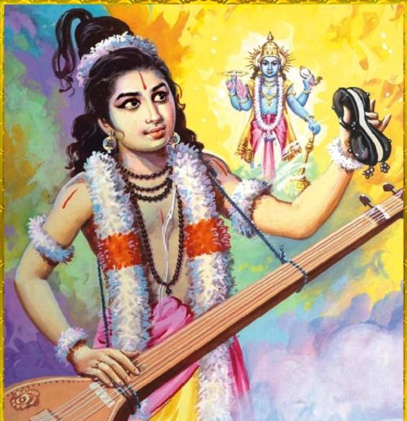
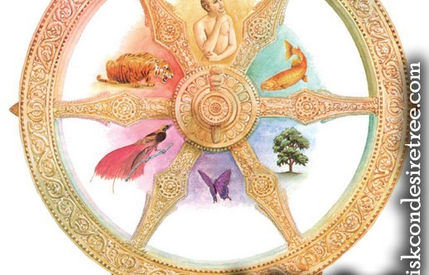
Surrender leads to Freedom SB 1.6.37 - T2+P4
Translation
Narada muni bade farewell to Vyasadeva
Playing his veena he left to wander at his free will
Purport
We all want freedom but freedom is attained by devotional service via the medium of Guru. Guru wants disciples to do sincere devotional service.
Narada muni got complete freedom to move at free will
Just like a faithful son/daughter has full access to father’s property
Free vs freedom – devotional service is free and we have the free will to take it
Most essential things in life is free
To surrender to the lord does not mean losing but gaining freedom.
Freedom from shackles of maya
Freedom to express our love

Slide 18
SB 1.6.38
अहो देवर्षिर्धन्योऽयं यत्कीर्तिं शार्ङ्गधन्वन: । गायन्माद्यन्निदं तन्‍त्र्या रमयत्यातुरं जगत् ॥ ३८ ॥
aho devarṣir dhanyo ’yaṁ yat-kīrtiṁ śārṅgadhanvanaḥ gāyan mādyann idaṁ tantryā ramayaty āturaṁ jagat
aho — all glory to; devarṣiḥ — the sage of the gods; dhanyaḥ — all success; ayam yat — one who; kīrtim — glories; śārṅga-dhanvanaḥ — of the Personality of Godhead; gāyan — singing; mādyan — taking pleasure in; idam — this; tantryā — by means of the instrument; ramayati — enlivens; āturam — distressed; jagat — world
All glory and success to Śrīla Nārada Muni because he glorifies the activities of the Personality of Godhead, and so doing he himself takes pleasure and also enlivens all the distressed souls of the universe.

Slide 19
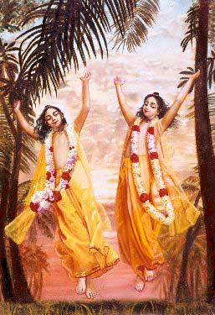
Glorification of Lord leads to endless bliss and cessation of distress SB 1.6.38 - T2+P4
Translation
Glorification of Lord and His activities implies success and happiness
Glorification of Lord leads to bliss and enlivens the distressed
Purport
We have no idea of the level of happiness and freedom pure devotees attain
What is felt as happiness in material world is maya’s illusion
Hog is also happy in filthy stool
No one can be happy in the material world – temporary ocean of misery
W.O.R.L.D : Walk Or Run Lose Definitely
Pure devotees mission is to enlighten all people and lead them back to Godhead
Servicing / co-operating with such pure devotees or their devotees we get benefited

Slide 20
Quiz :Words and meanings 1.6.35
A | B | C | D
yama-ādibhiḥ | kāma-lobha-hato | mukunda-sevayā | śāmyati
Service to Supreme Personality of Godhead the giver of liberation | be satisfied | by the process of practicing self-restraint | desires and lust for sense satisfaction is curbed
1 | 2 | 3 | 4

Slide 21
Quiz :Words and meanings 1.6.35
A | B | C | D
yama-ādibhiḥ | kāma-lobha-hato | mukunda-sevayā | śāmyati
by the process of practicing self-restraint | desires and lust for sense satisfaction is curbed | Service to Supreme Personality of Godhead the giver of liberation | be satisfied
3 | 4 | 1 | 2

Slide 22
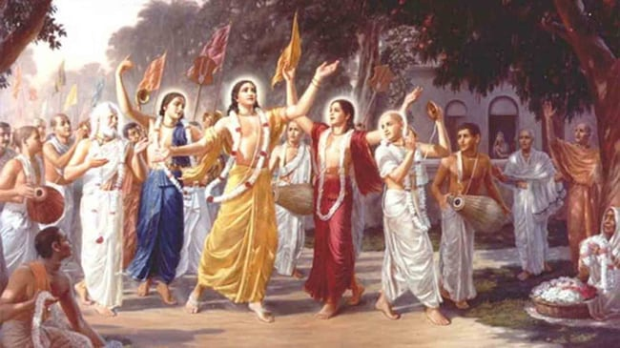

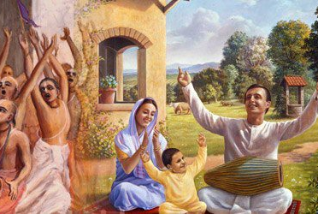
Take Home Points
Bhakti is topmost
Bhakti to Lord Sri Krishna Gives real satisfaction in the heart.
Higher taste is needed
Getting relief from lust is not sufficient we need the higher taste paraṁ dṛṣṭvā [BG 2.59] for real success and interview with Krishna
Pure Devotees are as transcendental as Lord
Hearing of the pastimes of devotees of Lord also gives us satisfaction.
Purity give us freedom and ability to handle distress
Just as a good son has access to all his father’s property, a pure bhakta can access any part of Lord’s creation freely.
Glorification of Lord gives us bliss and success

Slide 23
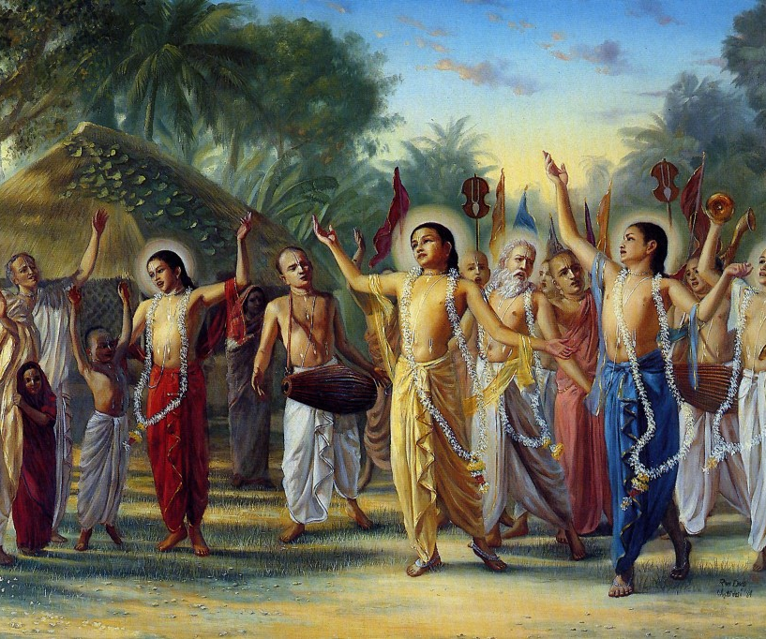
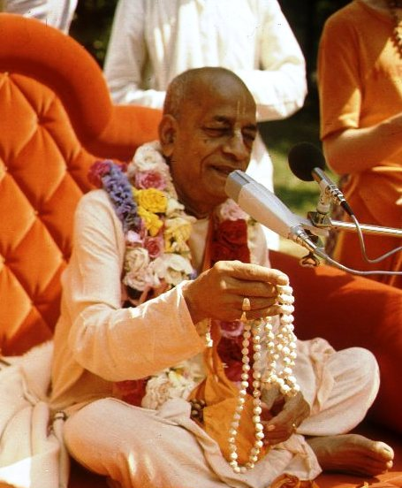
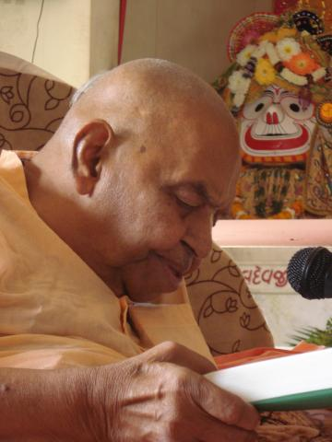

हरे कृष्णा
श्रील प्रभुपाद की जय
गुरुदेव की जय

Slide 24
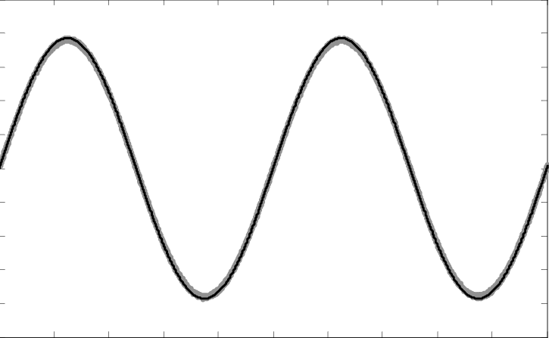
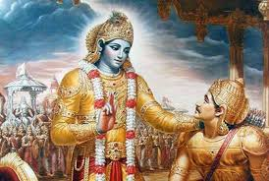


Ups and Downs of Life
Material world is designed to be full of 3 + 4 miseries
How to cope up with ups and downs of life? BG 2.14
Humbly tolerate respecting all
Add Krishna in your life (100,000)
Everything happens according to His plan [SB 1.9.16 / 1.8.19]

Slide 25
जीवन के उतार चढ़ाव
भौतिक दुनिया को 3 + 4 दुखों से भरा बनाया गया है
जीवन के उतार-चढ़ाव का सामना कैसे करें? BG 2.14
विनम्रतापूर्वक सभी का सम्मान करते हैं
अपने जीवन में कृष्ण को जोड़ें (1,00,000)
सब कुछ उसकी योजना के अनुसार होता है [SB 1.9.16 / 1.8.19]

Slide 26
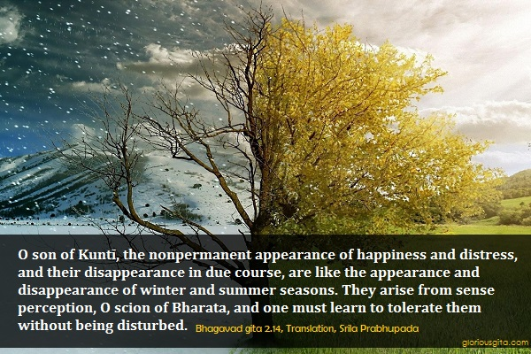

Slide 27
Tolerance
मात्रास्पर्शास्तु कौन्तेय शीतोष्णसुखदुःखदाः । आगमापायिनोऽनित्यास्तांस्तितिक्षस्व भारत ॥ १४ ॥
mātrā-sparśās tu kaunteya śītoṣṇa-sukha-duḥkha-dāḥ āgamāpāyino ’nityās tāṁs titikṣasva bhārata
mātrā-sparśāḥ — sensory perception; tu — only; kaunteya — O son of Kuntī; śīta — winter; uṣṇa — summer; sukha — happiness; duḥkha — and pain; dāḥ — giving; āgama — appearing; apāyinaḥ — disappearing; anityāḥ — nonpermanent; tān — all of them; titikṣasva — just try to tolerate; bhārata — O descendant of the Bharata dynasty.

Slide 28
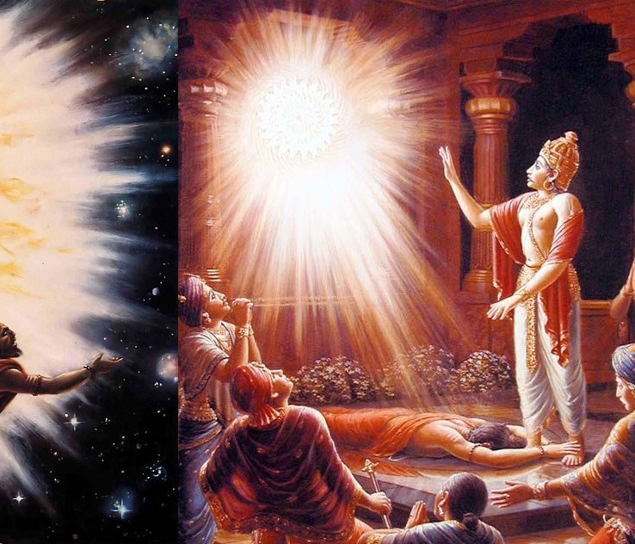
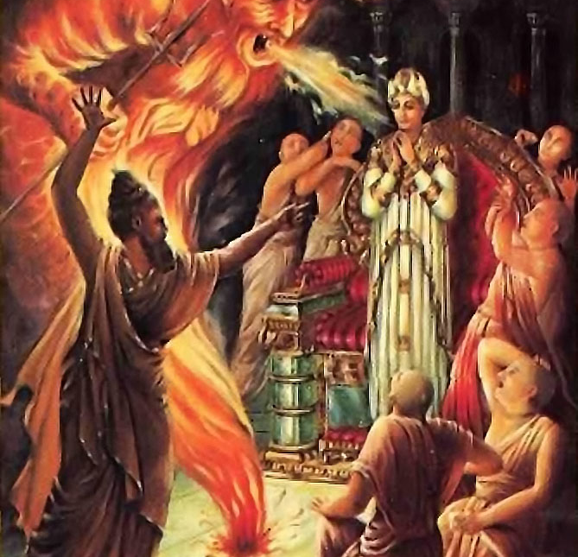
Happiness increases when karma improves
Durvasa muni insulted Ambarish Maharaj
Where there is bhakti, all good qualities reside. [SB 5.18.12]
Do not get dirty by the undue influence of the three modes of material nature. Particularly the mode of ignorance.

Slide 29
कर्म में सुधार होने पर खुशियाँ बढ़ती हैं
दुर्वासा मुनि ने अंबरीश महाराज का अपमान किया
जहां भक्ति होती है, वहां सभी अच्छे गुणों का वास होता है। [SB 5.18.12]
भौतिक प्रकृति के तीन गुन के अनुचित प्रभाव से गंदे न हों। खासतौर पर तमो गुन।

Slide 30
यस्यास्ति भक्तिर्भगवत्यकिञ्चना सर्वैर्गुणैस्तत्र समासते सुरा: । हरावभक्तस्य कुतो महद्गुणा मनोरथेनासति धावतो बहि: ॥ १२ ॥
All the demigods and their exalted qualities, such as religion, knowledge and renunciation, become manifest in the body of one who has developed unalloyed devotion for the Supreme Personality of Godhead, Vāsudeva. On the other hand, a person devoid of devotional service and engaged in material activities has no good qualities. Even if he is adept at the practice of mystic yoga or the honest endeavor of maintaining his family and relatives, he must be driven by his own mental speculations and must engage in the service of the Lord’s external energy. How can there be any good qualities in such a man? [SB 5.18.12]

Slide 31
Synonyms
yasya — of whom; asti — there is; bhaktiḥ — devotional service; bhagavati — to the Supreme Personality of Godhead; akiñcanā — without any motive; sarvaiḥ — with all; guṇaiḥ — good qualities; tatra — there (in that person); samāsate — reside; surāḥ — all the demigods; harau — unto the Supreme Personality of Godhead; abhaktasya — of a person who is not devoted; kutaḥ — where; mahat-guṇāḥ — good qualities; manorathena — by mental speculation; asati — in the temporary material world; dhāvataḥ — who is running; bahiḥ — outside.

Slide 32
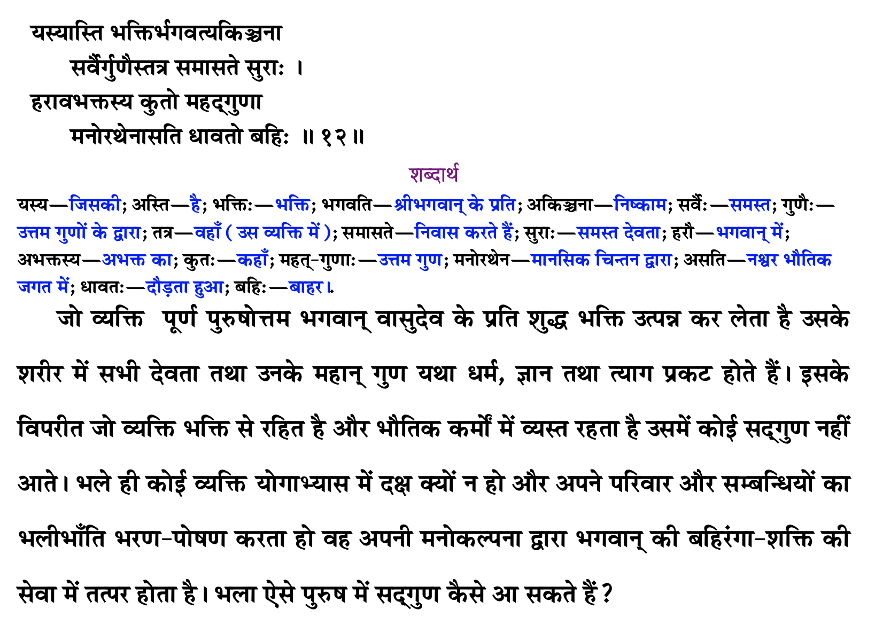

Slide 33
Reviving our original quality
As explained in the next verse, Kṛṣṇa is the original source of all living entities. This is confirmed in Bhagavad-gītā (15.7), wherein Kṛṣṇa says:
mamaivāṁśo jīva-loke jīva-bhūtaḥ sanātanaḥ manaḥ ṣaṣṭhānīndriyāṇi prakṛti-sthāni karṣati
“The living entities in this conditioned world are My eternal, fragmental parts. Due to conditioned life, they are struggling very hard with the six senses, which include the mind.” All living entities are part and parcel of Kṛṣṇa, and therefore when they revive their original Kṛṣṇa consciousness, they possess all the good qualities of Kṛṣṇa in a small quantity. When one engages himself in the nine processes of devotional service (śravaṇaṁ kīrtanaṁ viṣṇoḥ smaraṇaṁ pāda-sevanam/ arcanaṁ vandanaṁ dāsyaṁ sakhyam ātma-nivedanam), one’s heart becomes purified, and he immediately understands his relationship with Kṛṣṇa. He then revives his original quality of Kṛṣṇa consciousness.

Slide 34
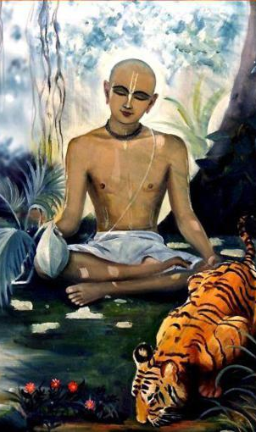
Qualities of Devotee Haridas Thakur
In the Ādi-līlā of Caitanya-caritāmṛta, Chapter Eight, there is a description of some of the qualities of devotees. For example, Śrī Paṇḍita Haridāsa is described as being very well-behaved, tolerant, peaceful, magnanimous and grave. In addition, he spoke very sweetly, his endeavors were very pleasing, he was always patient, he respected everyone, he always worked for everyone’s benefit, his mind was free of duplicity, and he was completely devoid of all malicious activities. These are all originally qualities of Kṛṣṇa, and when one becomes a devotee they automatically become manifest. Śrī Kṛṣṇadāsa Kavirāja, the author of Caitanya-caritāmṛta, says that all good qualities become manifest in the body of a Vaiṣṇava and that only by the presence of these good qualities can one distinguish a Vaiṣṇava from a non-Vaiṣṇava.

Slide 35
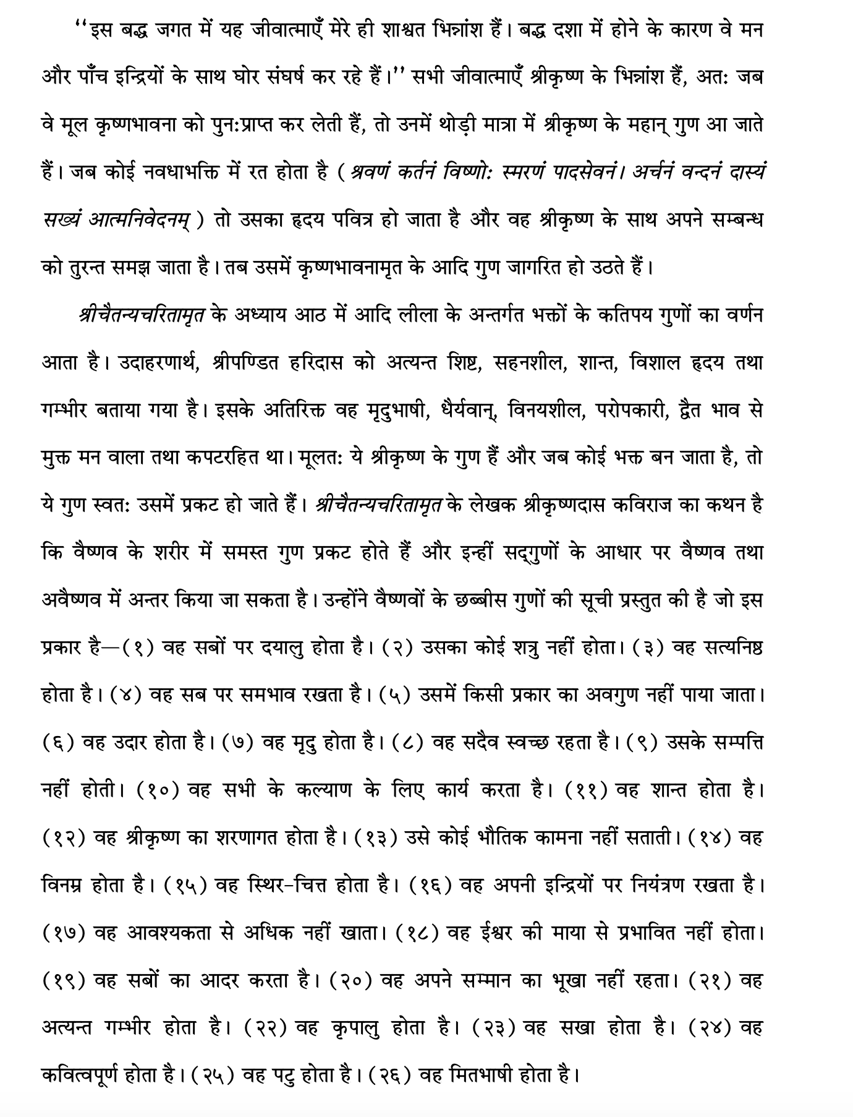

Slide 36
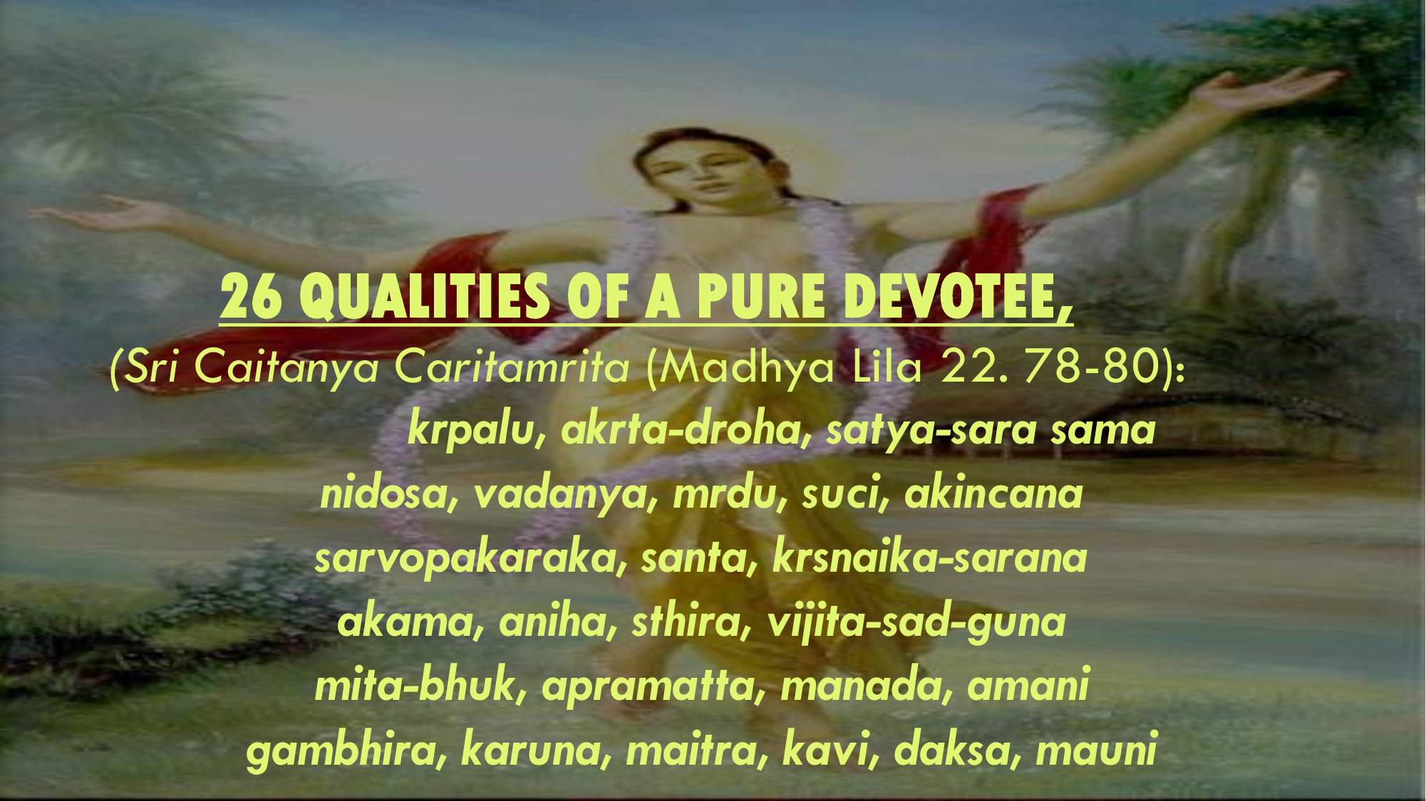
Twenty-six good qualities of a Vaiṣṇava
Kṛṣṇadāsa Kavirāja lists the following twenty-six good qualities of a Vaiṣṇava:
(1) He is very kind to everyone. (2) He does not make anyone his enemy. (3) He is truthful. (4) He is equal to everyone.
(5) No one can find any fault in him. (6) He is magnanimous. (7) He is mild. (8) He is always clean. (9) He is without possessions.
(10) He works for everyone’s benefit. (11) He is very peaceful. (12) He is always surrendered to Kṛṣṇa.
(13) He has no material desires. (14) He is very meek. (15) He is steady. (16) He controls his senses.
(17) He does not eat more than required. (18) He is not influenced by the Lord’s illusory energy. (19) He offers respect to everyone. (20) He does not desire any respect for himself.
(21) He is very grave. (22) He is merciful. (23) He is friendly. (24) He is poetic. (25) He is expert. (26) He is silent.

Slide 37


Slide 38
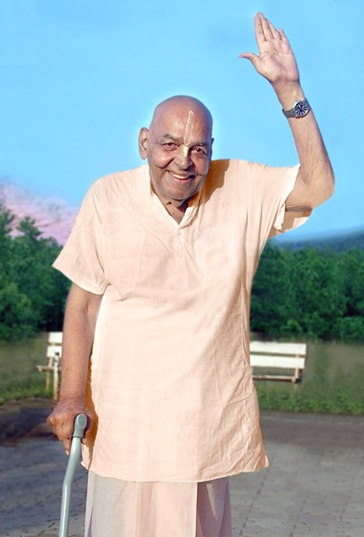
Patience leads to liberation
यं हि न व्यथयन्त्येते पुरुषं पुरुषर्षभ । समदुःखसुखं धीरं सोऽमृतत्वाय कल्पते ॥ १५ ॥
yaṁ hi na vyathayanty ete puruṣaṁ puruṣarṣabha sama-duḥkha-sukhaṁ dhīraṁ so ’mṛtatvāya kalpate
yam — one to whom; hi — certainly; na — never; vyathayanti — are distressing; ete — all these; puruṣam — to a person; puruṣa-ṛṣabha — O best among men; sama — unaltered; duḥkha — in distress; sukham — and happiness; dhīram — patient; saḥ — he; amṛtatvāya — for liberation; kalpate — is considered eligible.
O best among men [Arjuna], the person who is not disturbed by happiness and distress and is steady in both is certainly eligible for liberation.[BG 2.15]

Slide 39
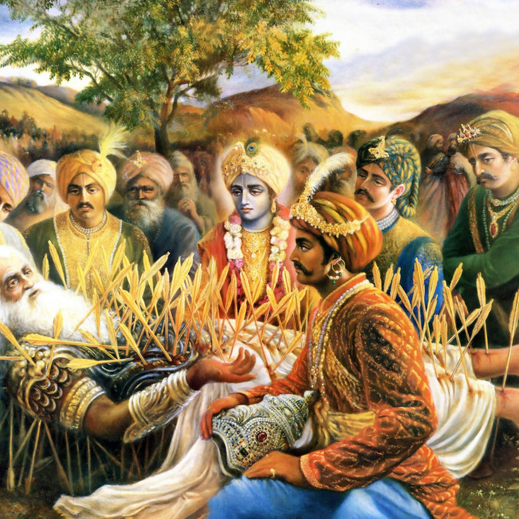
No one knows His plan
न ह्यस्य कर्हिचिद्राजन् पुमान् वेद विधित्सितम् । यद्विजिज्ञासया युक्ता मुह्यन्ति कवयोऽपि हि ॥ १६ ॥
na hy asya karhicid rājan pumān veda vidhitsitam yad vijijñāsayā yuktā muhyanti kavayo ’pi hi
na — never; hi — certainly; asya — His; karhicit — whatsoever; rājan — O King; pumān — anyone; veda — knows; vidhitsitam — plan; yat — which; vijijñāsayā — with exhaustive inquiries; yuktāḥ — being engaged; muhyanti — bewildered; kavayaḥ — great philosophers; api — even; hi — certainly.
O King, no one can know the plan of the Lord [Śrī Kṛṣṇa]. Even though great philosophers inquire exhaustively, they are bewildered.[SB 1.19.16]

Slide 40
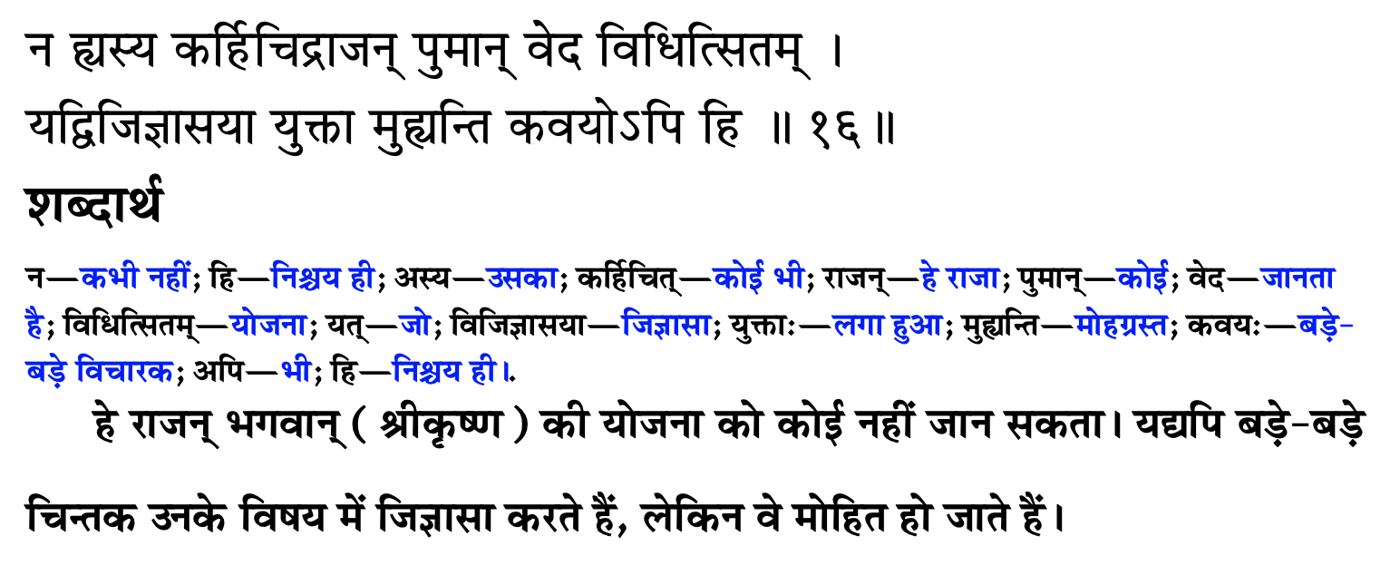
उसकी योजना कोई नहीं जानता

Slide 41
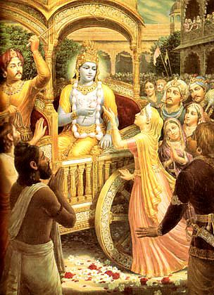
The invisible actor
मायाजवनिकाच्छन्नमज्ञाधोक्षजमव्ययम् । न लक्ष्यसे मूढद‍ृशा नटो नाट्यधरो यथा ॥ १९ ॥
māyā-javanikācchannam ajñādhokṣajam avyayam na lakṣyase mūḍha-dṛśā naṭo nāṭyadharo yathā
māyā — deluding; javanikā — curtain; ācchannam — covered by; ajñā — ignorant; adhokṣajam — beyond the range of material conception (transcendental); avyayam — irreproachable; na — not; lakṣyase — observed; mūḍha-dṛśā — by the foolish observer; naṭaḥ — artist; nāṭya-dharaḥ — dressed as a player; yathā — as.
Being beyond the range of limited sense perception, You are the eternally irreproachable factor covered by the curtain of deluding energy. You are invisible to the foolish observer, exactly as an actor dressed as a player is not recognized.[SB 1.8.19]

Slide 42
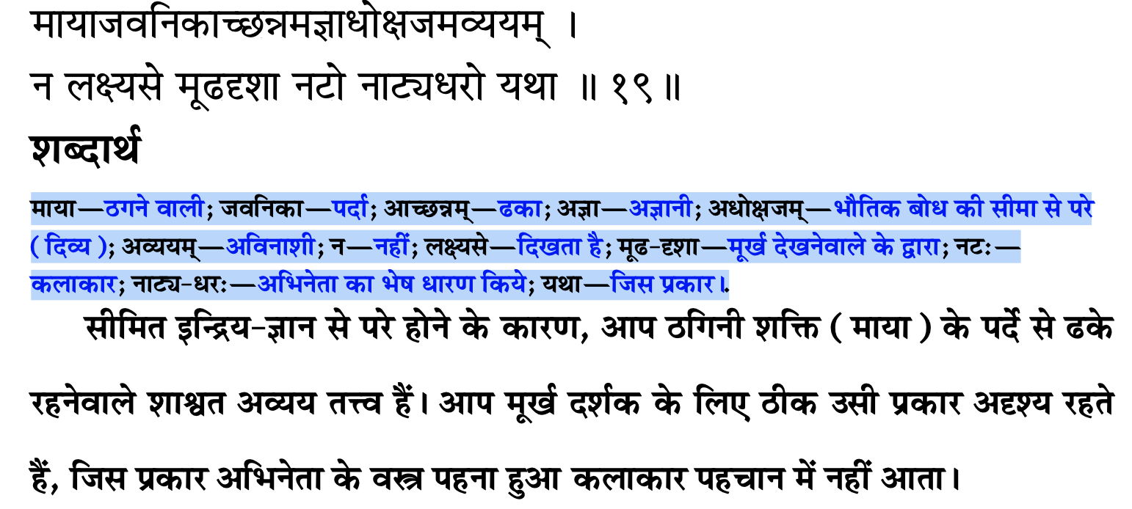
अदृश्य अभिनेता

Slide 43
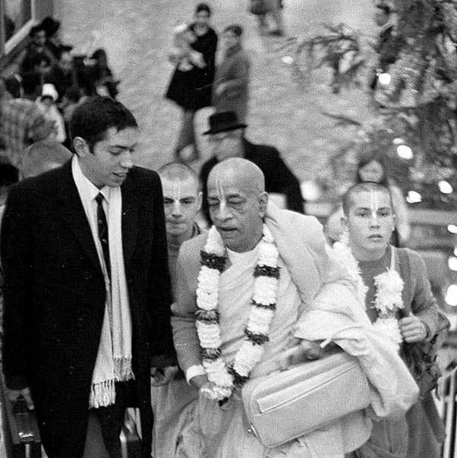
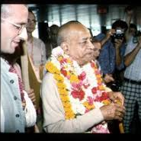
Blame yourself not others – See only Krishna
बहूनां जन्मनामन्ते ज्ञानवान्मां प्रपद्यते । वासुदेव: सर्वमिति स महात्मा सुदुर्लभ: ॥ १९ ॥
bahūnāṁ janmanām ante jñānavān māṁ prapadyate vāsudevaḥ sarvam iti sa mahātmā su-durlabhaḥ
bahūnām — many; janmanām — repeated births and deaths; ante — after; jñāna-vān — one who is in full knowledge; mām — unto Me; prapadyate — surrenders; vāsudevaḥ — the Personality of Godhead, Kṛṣṇa; sarvam — everything; iti — thus; saḥ — that; mahā-ātmā — great soul; su-durlabhaḥ — very rare to see.
After many births and deaths, he who is actually in knowledge surrenders unto Me, knowing Me to be the cause of all causes and all that is. Such a great soul is very rare.[BG 7.19]

Slide 44
Points to remember
Source of all good qualities is ……
Where there is …… all good qualities reside
Real doer is …..
Everything happens according to ….. plans.
If we develop habit of seeing Krishna in all circumstances, then we will not have ….. towards anybody.
Blame ….. not others

Slide 45
कृपया याद रखें
सभी अच्छे गुणों का स्रोत ….. है
जहां ….. हैं वहां सभी अच्छे गुण निवास करते हैं
असली कर्ता ….. है
सब कुछ ….. की योजना के अनुसार होता है
यदि हम सभी परिस्थितियों में ….. को देखने की आदत विकसित करेंगे तो हम किसी के प्रति ईर्ष्या नहीं करेंगे.
….. को दोष दें दूसरों को नहीं

Slide 46
Eat sparingly and depend on Krishna
One who eats sparingly, eats away the sorrows.
If something happens to the body, then first thing you do is to shut our mouth.
Firstly, don’t talk much or get angry at anyone. When you are not the cause, then why are you angry?

Slide 47
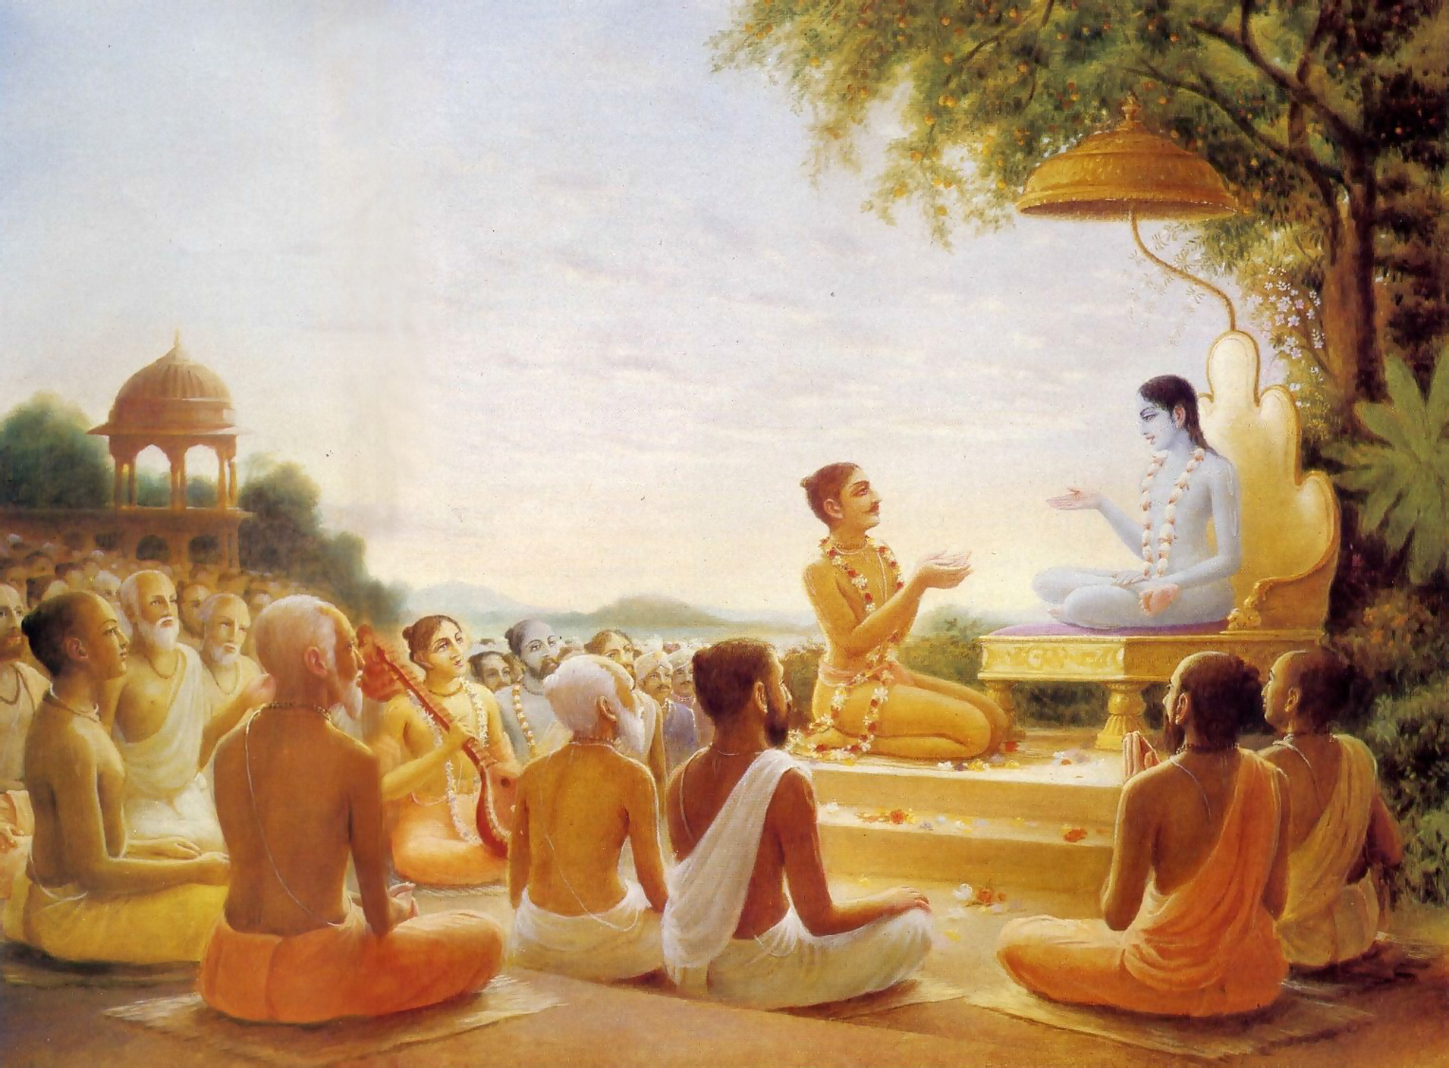
We have to go!
पुनश्च भूयाद्भगवत्यनन्ते
रति: प्रसङ्गश्च तदाश्रयेषु । महत्सु यां यामुपयामि सृष्टिं
मैत्र्यस्तु सर्वत्र नमो द्विजेभ्य: ॥ १६ ॥
punaś ca bhūyād bhagavaty anante
ratiḥ prasaṅgaś ca tad-āśrayeṣu mahatsu yāṁ yām upayāmi sṛṣṭiṁ
maitry astu sarvatra namo dvijebhyaḥ
Again, offering obeisances unto all you brāhmaṇas, I pray that if I should again take my birth in the material world I will have complete attachment to the unlimited Lord Kṛṣṇa, association with His devotees and friendly relations with all living beings. [SB 1.9.16]

Slide 48
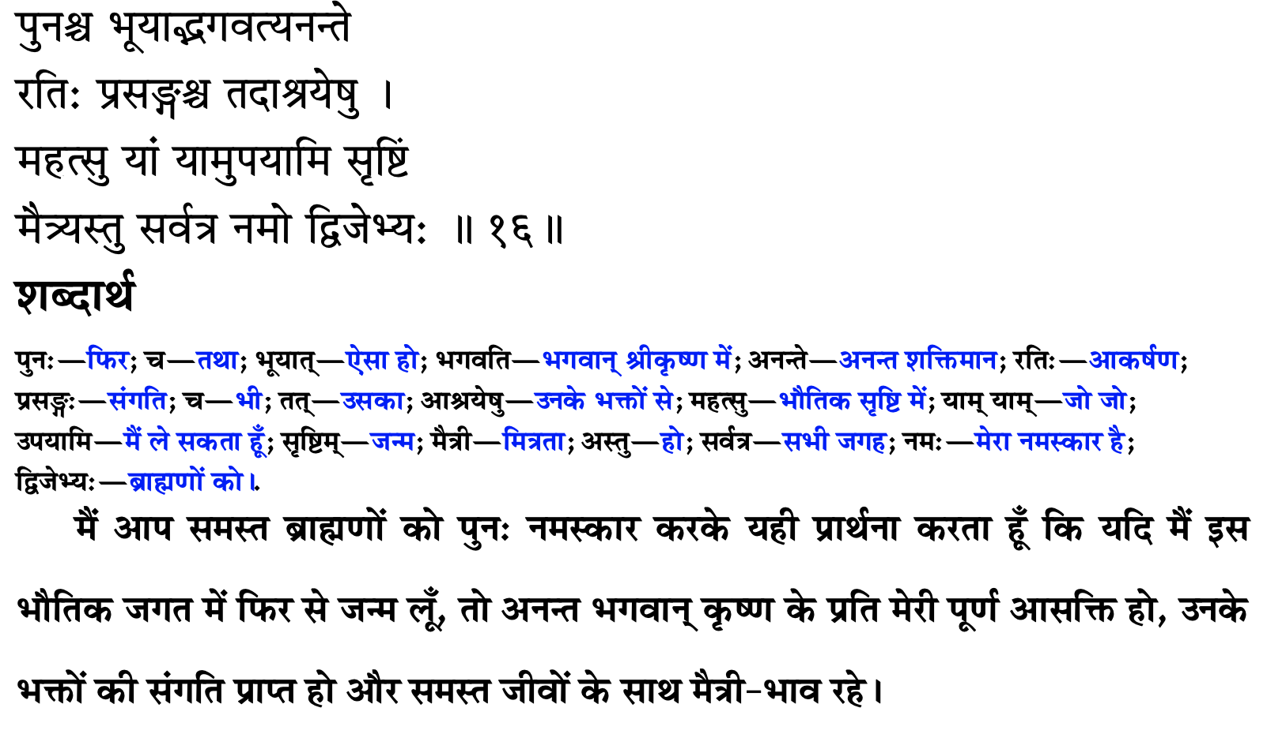
हमने जाना है

Slide 49
Try and God will help you from within
May I be always attracted towards You.
May I have attraction towards those who are surrendered to Kåñëa. May I have association of devotees.
May I have friendly and equal relations with everybody.
You can have very workable relationships with everybody. No intimacy!
dadämi buddhi yogam tam. God gives you intelligence
By creating amicable relationship with everybody, whatever time is saved, should be invested in the pages of Bhägavatam.

Slide 50
कोशिश करो और भगवान तुम्हारे भीतर से मदद करेंगे
मैं हमेशा कृष्ण की ओर आकर्षित रहूं.
क्या मुझे उन लोगों के प्रति आकर्षण है जो कृष्ण के सामने आत्मसमर्पण कर रहे हैं। मुझे भक्तों की संगति करनी चाहिए
मेरा सभी के साथ दोस्ताना और समान संबंध हो.
हर किसी के साथ आपके बहुत काम के रिश्ते हो सकते हैं। कोई अंतरंगता नहीं!
दादामि बुद्धी योगम् तम्। ईश्वर आपको बुद्धि देता है
हर किसी के साथ सौहार्दपूर्ण संबंध बनाकर, जो भी समय बचता है, उसे भावागम के पन्नों में निवेश करना चाहिए।

Slide 51
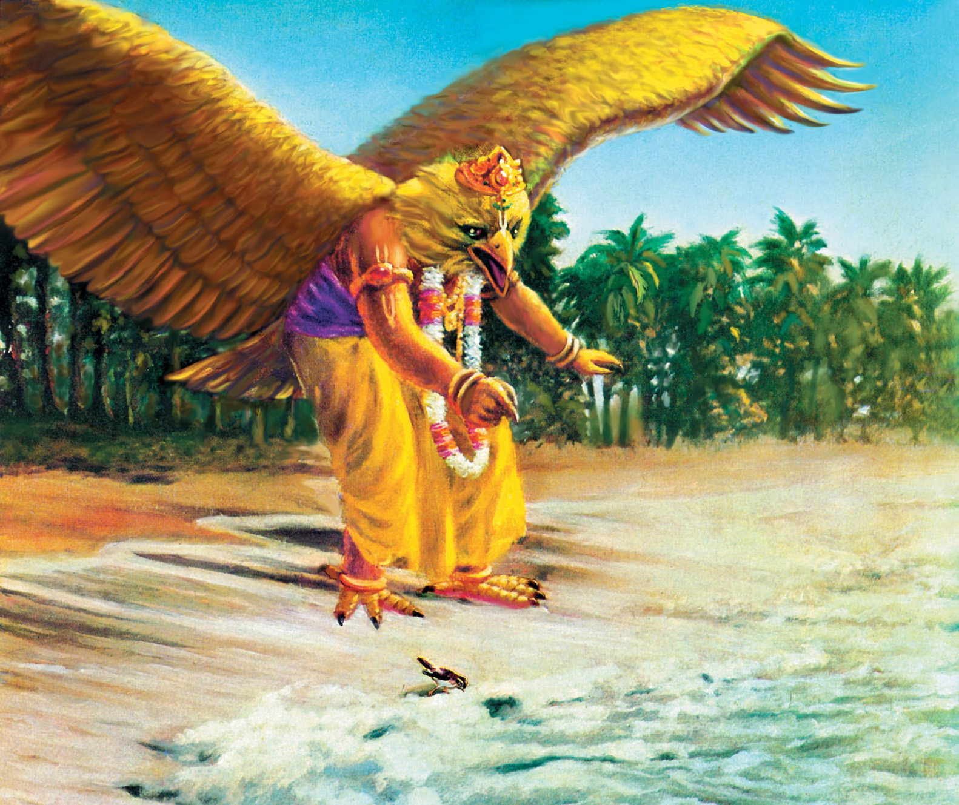

Slide 52
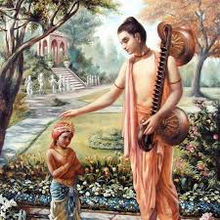
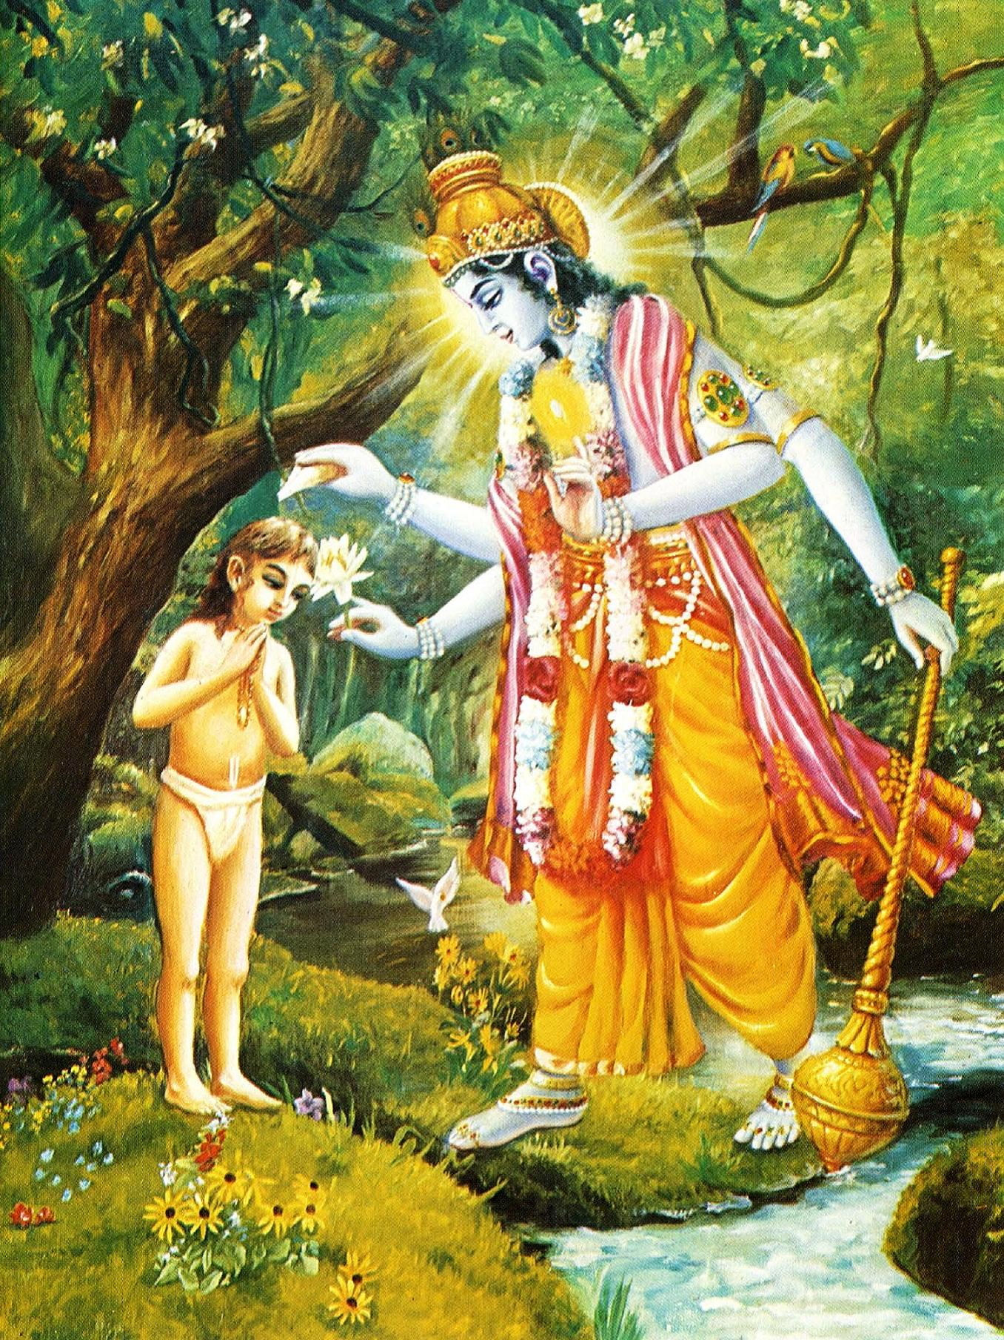
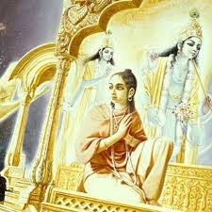
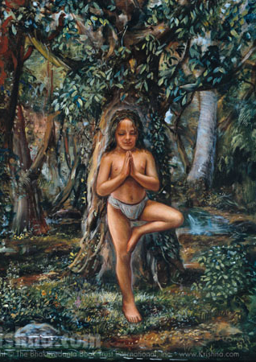
Dhruva Maharaj

Slide 53





Life of Bhishma Deva

Slide 54



Trials in life of Pandavas
Oh, what terrible sufferings and what terrible injustices you good souls suffer for being the sons of religion personified. You did not deserve to remain alive under those tribulations, yet you were protected by the brāhmaṇas, God and religion.
As far as my daughter-in-law Kuntī is concerned, upon the great General Pāṇḍu’s death, she became a widow with many children, and therefore she suffered greatly. And when you were grown up she suffered a great deal also because of your actions.
In my opinion, this is all due to inevitable time, under whose control everyone in every planet is carried, just as the clouds are carried by the wind. [SB 1.9.12-14]

Slide 55
हरे कृष्णा
श्रील प्रभुपाद की जय
गुरुदेव की जय

